Slide 1

The of Regulation
Parent Session

Slide 2
What are The Zones of Regulation?
- Originally developed by an Occupational Therapist in 2011
- Provides us an easy way to think and talk about how we feel on the inside
- Once we understand our feelings and zones, we can learn to use tools/strategies to support regulation
- Helps make the complex skill of regulation more concrete for learners and those who support them.
https://www.youtube.com/watch?v=L0e-oMZi000

Slide 3
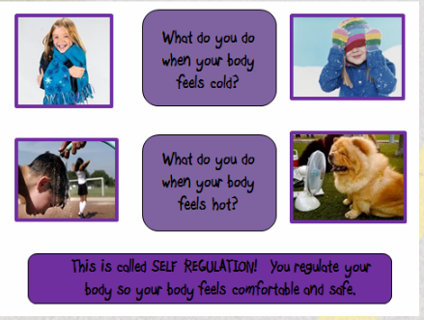
What is self regulation?
The ability to focus your attention, control your emotions and manage your thinking, behaviour and feelings.

Slide 4
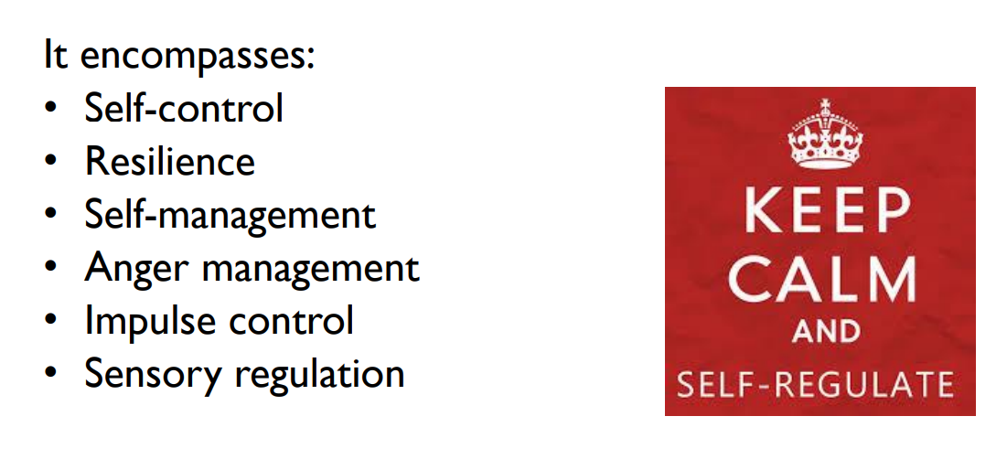
What is self regulation?

Slide 5
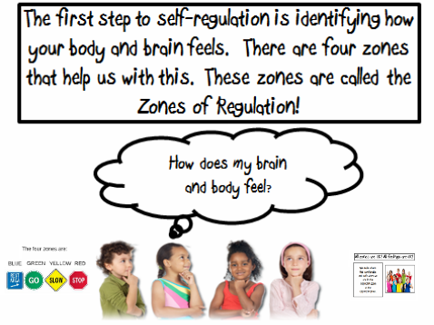

Slide 6
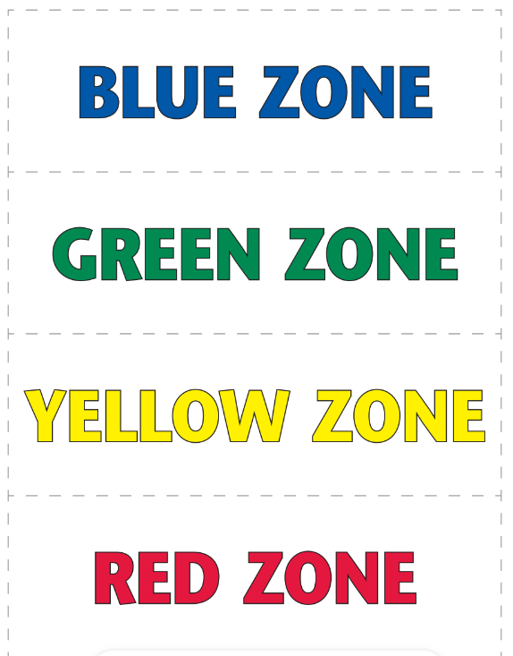
What feelings do you think of when you see these colours?

Slide 7
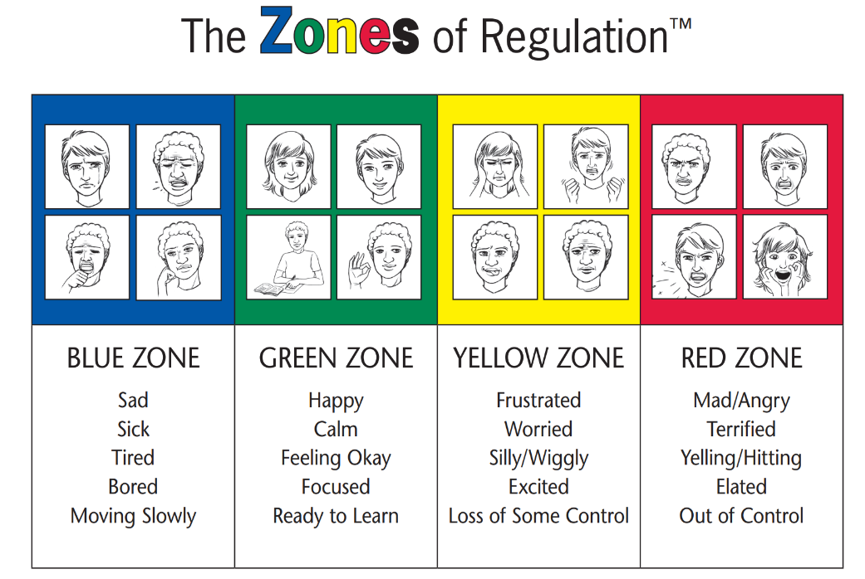

Slide 8
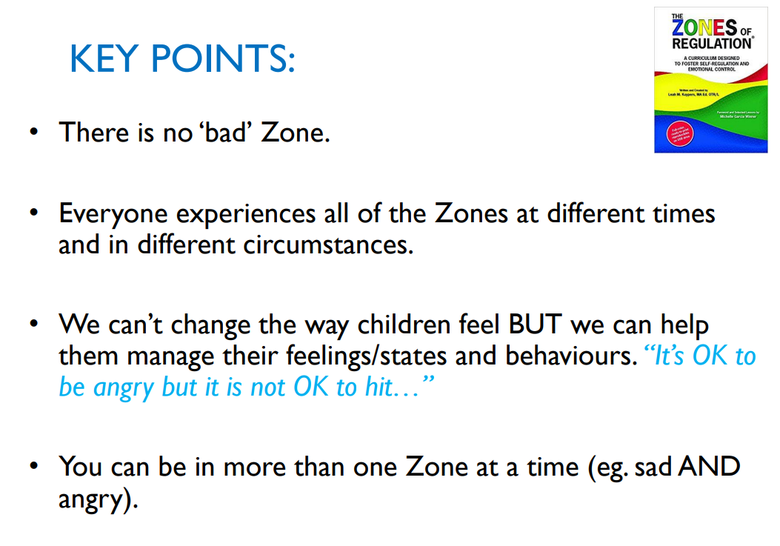

Slide 9
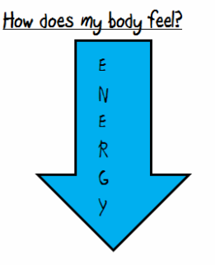
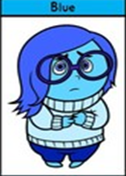

The Blue Zone
We are expected to be in the Blue Zone just before bed time or when we are watching the TV. We are running slow! We might be tired or sad. This is an unexpected zone to be in for learning.

Slide 10
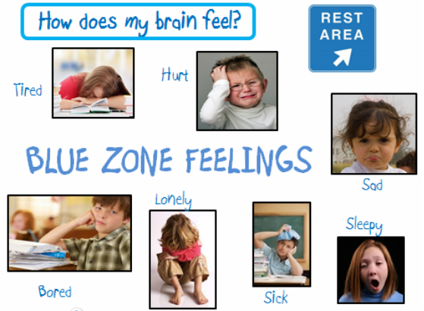

Slide 11
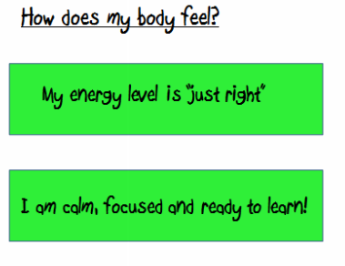


The green zone…..the learning zone!!
We are expected to be in the Green Zone while we are learning. It is when our brains and bodies are relaxed and focused!

Slide 12
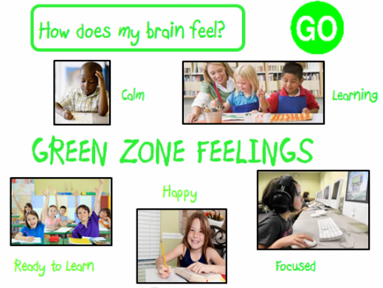

Slide 13
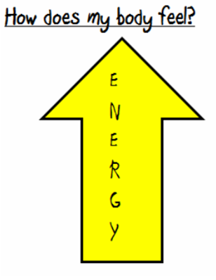
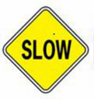
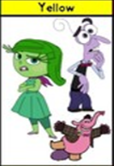
The Yellow Zone……during play time, lunch time and even at the end of the day, it’s expected for us to be in the YELLOW ZONE!!

Slide 14
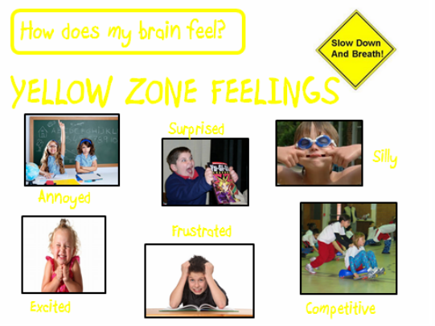

Slide 15
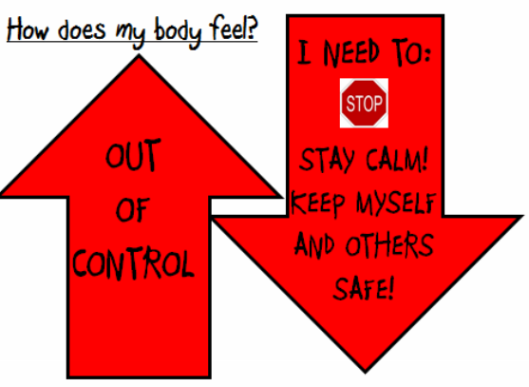
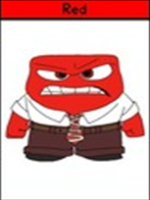

The Red Zone….when we are at school, the red zone is never expected! We must keep ourselves and others safe!

Slide 16
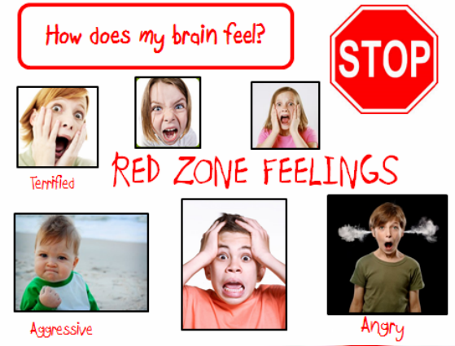

Slide 17
What can you do to help?

Slide 18
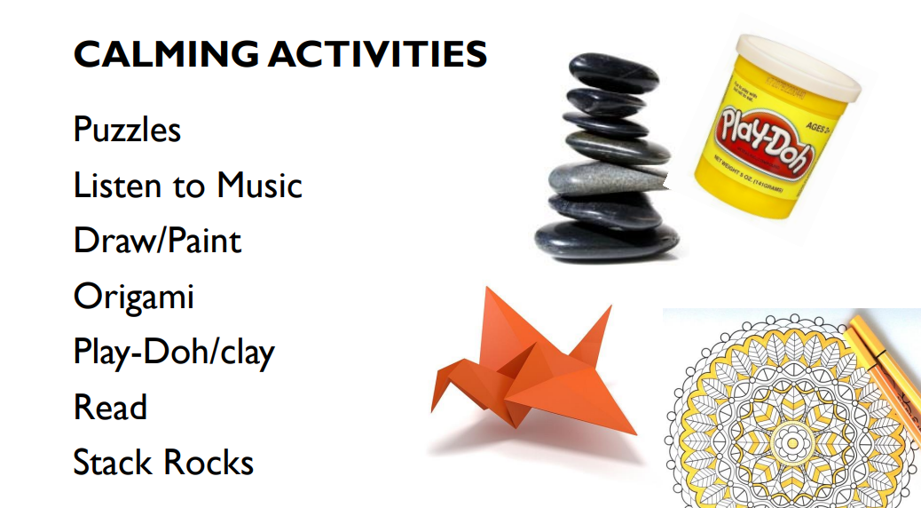

Slide 19
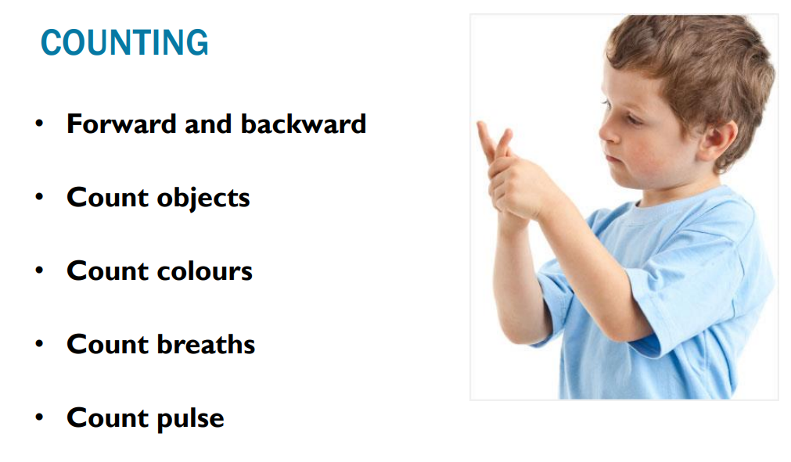

Slide 20
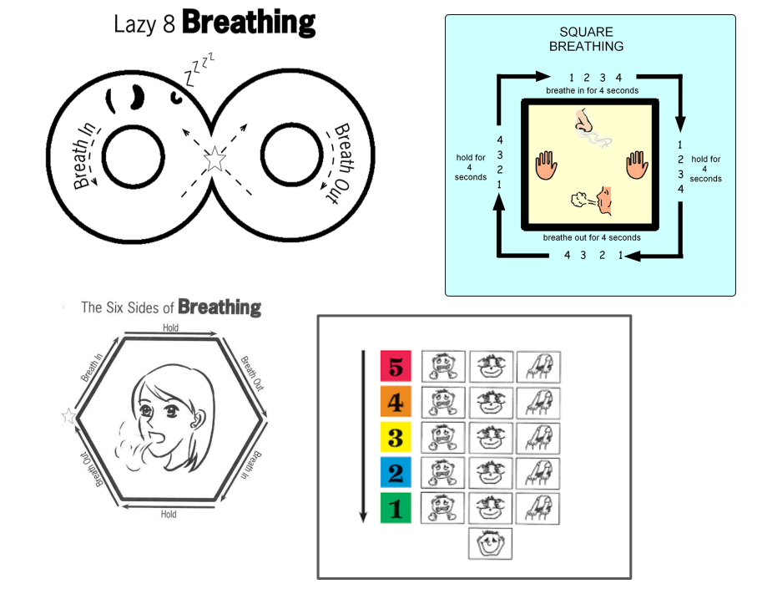

Slide 21
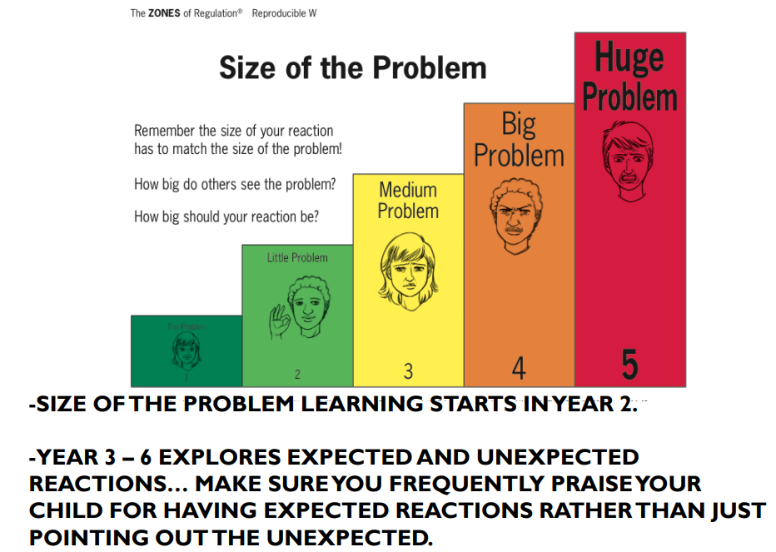

Slide 22
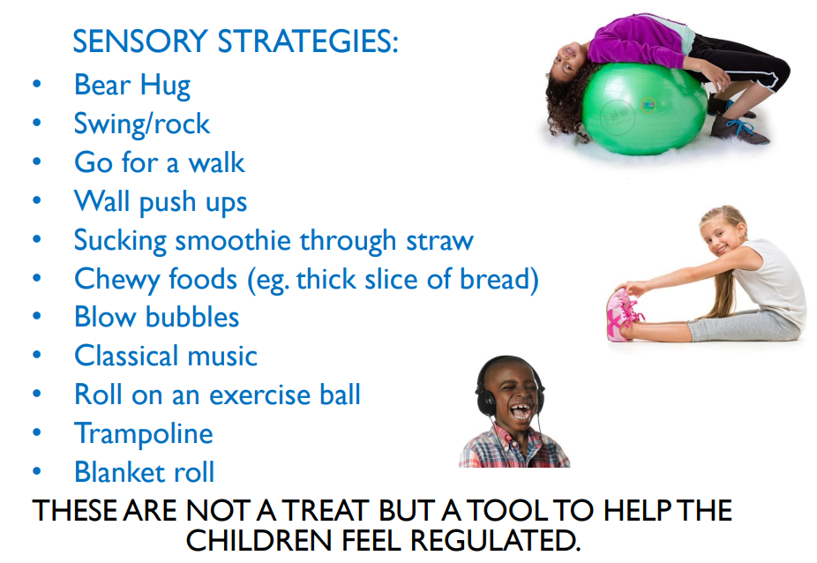

Slide 23
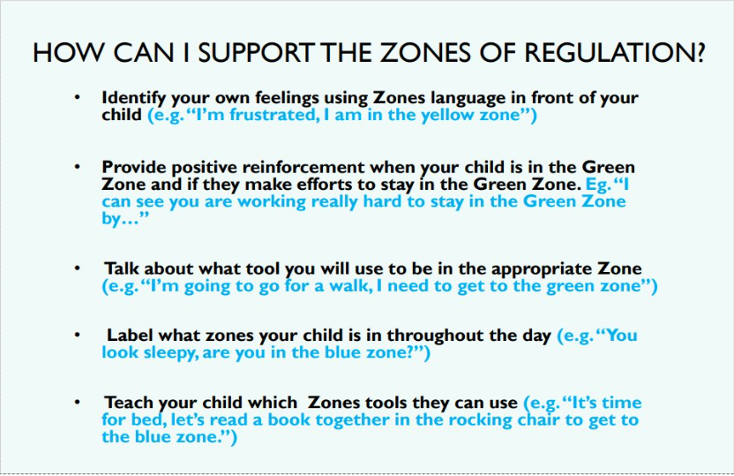

Slide 24
What now?
We have introduced the Zones to the children, you may have heard them talk about this.
We will have sessions and assemblies in school each half term.
We will do lessons around this each half term.

